Slide 1
Software Project Management
In the name of Allah, the Beneficent, the Merciful
Lecture 02:
Software Project Initiation

Slide 2
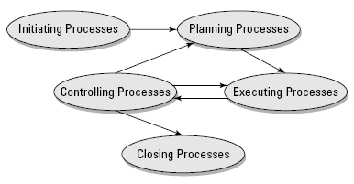
PMI Process Groups

Slide 3
Initiating a Software Project
Successful Project Managers always starts by identifying the project purpose.
What You Need To Know?
Why is Software Project Being Initiated?
Do all Stakeholders agree on Deliverables

Slide 4
Why is Software Project Being Initiated?
Business Needs:
Reducing Costs
Increasing Revenue
Increasing Productivity & Efficiency
Solving Problem
Taking Advantage of Market Opportunities
etc, etc, . . .

Slide 5
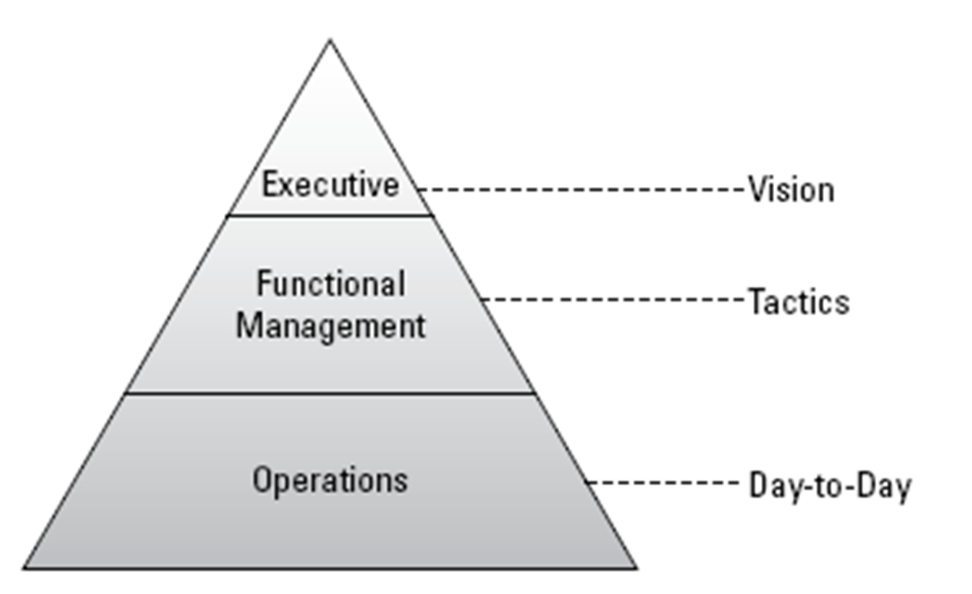
Talking To Stakeholders
Completion criteria
Who will get affected in the organization
Project priority
Budgetary range

Slide 6
Initiation activities
Ownership for:
project execution
project delivery
and customer acceptance
is entrusted to a software project manager
The software project manager is provided with
support commitments
from the service departments in the organization.
The project starts out on the “right foot.”
To ensure success

Slide 7
Initiating
Initiating processes are performed at
the beginning of a project
or a new phase
For the very first time, a project manager:
is assigned to the project
and is authorized to take decisions and manage the project.
A project requires a strong business case, one that clearly shows the need for the project.
Output: creation and authorization of project charter, and identification of and data collection of project stakeholders

Slide 8
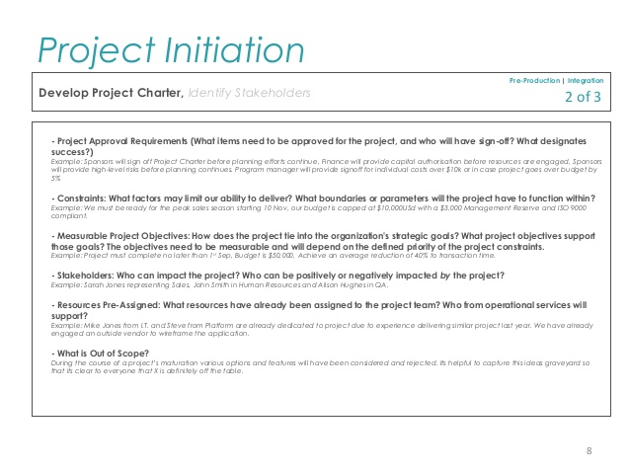

Slide 9
Project Charter
The Project Charter Document.
The Project Charter formally authorizes a project or a project phase.
The Project Charter is best delivered at a project kickoff by the project sponsor so that the Project Manager is given explicit authority by the one sponsor.
Specifically, the Project Charter provides the project manager (PM) with the authority to bring the project team together to accomplish the task of completing the project successfully

Slide 10
Project Charter Document
Project Description
Explain what the project is, and how it will be accomplished
Explain the ultimate intended outcome of the project.
Project Purpose
Tie the purpose to the organization's strategic goals and
Business Case
how the project going to benefit the organization.
Business Requirements
high level business requirements that the project is going to fulfill.
Assumptions
conditions at the start of the project that must be considered
Constraints
events that must be considered for which the project has no control over

Slide 11
Project Charter Document…
Risks
generally at a high level since not much is known yet
Project Deliverables
what is going to be delivered at the completion of the project
Project Life Cycle Methodology and Tools
methodology the project will be using
Project Milestones
Identify the project milestones
Project Manager
project manager has the authority to complete the project

Slide 12
Project Charter Document…
Project Roles and Responsibilities
other key roles and responsibilities within the project team
Authorization
names of those business sponsors that must sign the Project Charter

Slide 13
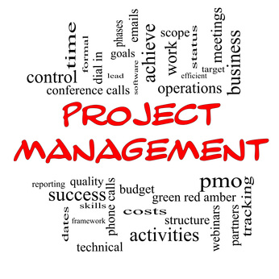
Project Management Office-level Activities
Identifying the software Project Manager
Availability
Past experience
Expertise
Capability to handle the
size of the present team
Willingness to handle the project

Slide 14
Project Management Office-level Activities
Preparing/Handing over the Project dossier to the software Project Manager
The project initiation note
The RFP
proposal,
purchase order
Technical specifications
Important project milestones
Commitment dates
Other requirements
communication mechanisms
progress reporting formats
Pointers to past experience
Invoicing information

Slide 15
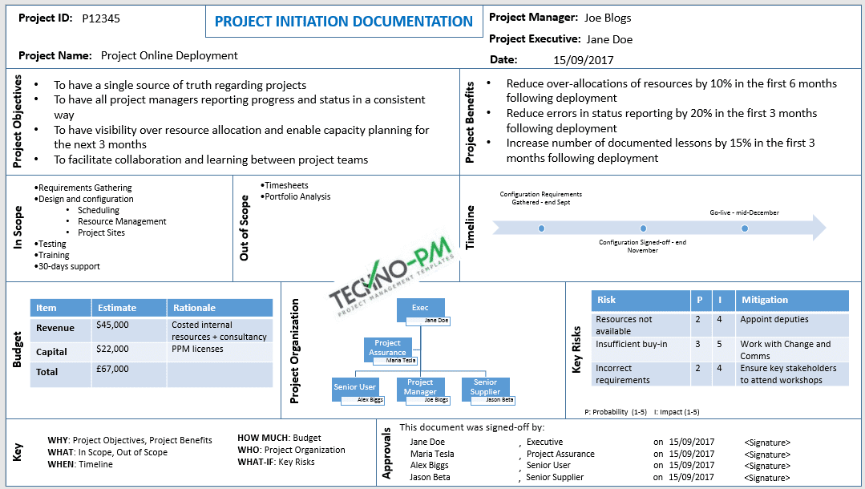
Project Initiation note

Slide 16
Project Management Office-level Activities
Coordinating Allocation of Project resources:
that are not allocated to any project
that are allocated to other projects, but are likely to be available to fulfill resource requests raised by the SPM
that are allocated to other projects, but are being used as a resource buffer

Slide 17
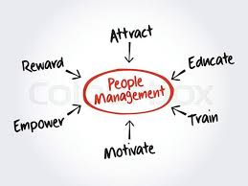
Project Management Office-level Activities
Human resources:
The PMO coordinates with the human resources
Recruit from the market
Hire temporary workers from a consulting company
Hire part-time workers
Borrow workers from a sister company or division
Ask existing resources to work extra hours

Slide 18
Project Management Office-level Activities
Computer resources:
The PMO coordinates with the systems administration department to arrange for additional computer resources
Procure new systems/hardware
Rent systems or hardware
Request that employees work in shifts and share resources

Slide 19
Project Management Office-level Activities
Monetary resources:
The PMO coordinates with the finance department to arrange for the additional financial resources.
An advance from the customer
Leveraging the financial reserves of the company
Borrowing from the market
Asset sales

Slide 20
Project Management Office-level Activities
Assisting the software Project Manager in obtaining necessary service Level Agreements from departments in the organization
SLAs for each project are negotiated between the SPM and the service departments
PMO coordinates setting up meetings with outside resources
and ensures that an amicable resolution is achieved between a project activity and the responsible service department.

Slide 21
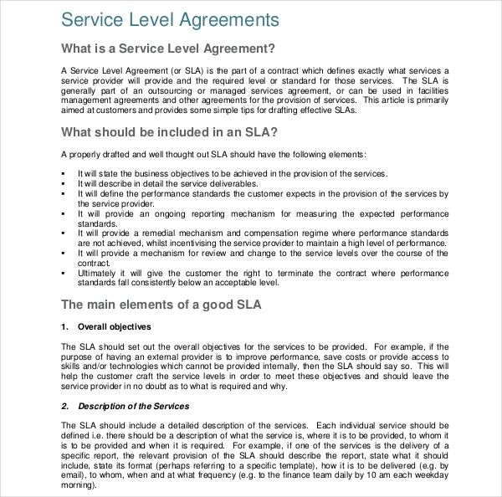

Slide 22
Project Management Office-level Activities
Assisting the software Project Manager with the Project Kickoff Meeting
Determines the date for the kickoff meeting
Coordinates and ensures that all project stakeholders are represented at the project kickoff meeting
Assists the SPM in getting project stakeholders to accept the roadmap that has been laid out for project execution and in ensuring that project stakeholders support the project
Formalizes the kickoff meeting by recording the minutes of themeeting (including issues and action items) and circulating the minutes to all stakeholder

Slide 23
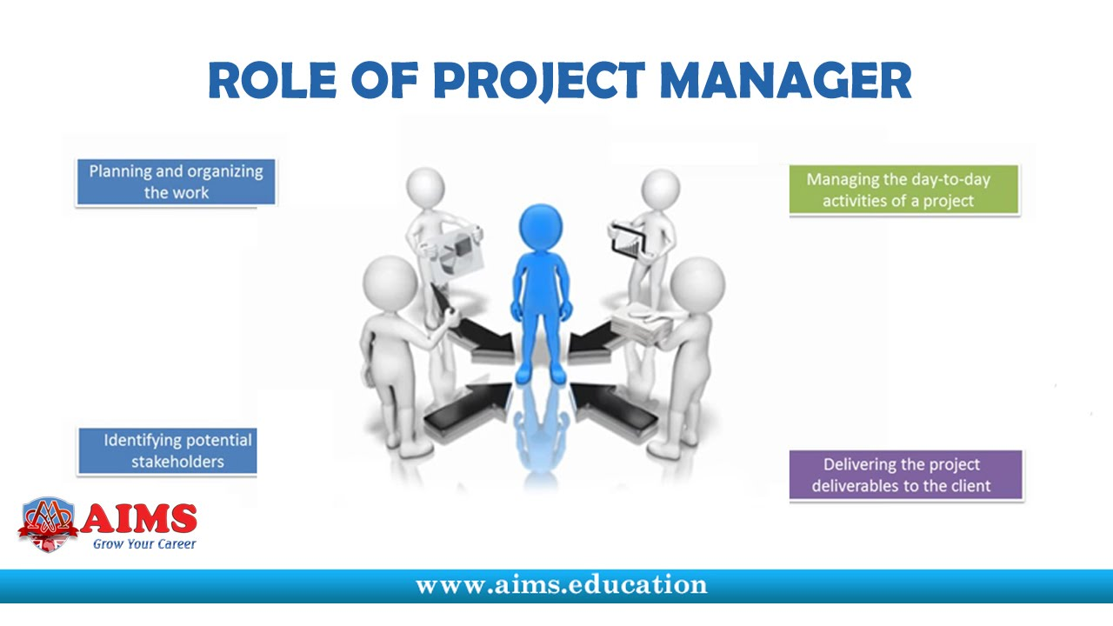
Software Project Manager-level Activities
Ensuring that Project specifications are Complete
Technical specifications
Delivery commitments
Details of milestone events

Slide 24
Software Project Manager-level Activities
Reviewing estimates and revisions/Updates of estimates
New specification
Significant alteration
Review the estimate prepared during the project acquisition stage
Determines the extent of variation
Determines whether to use the existing estimates
Revise and update the acquisition estimate
Re-estimate if needed

Slide 25
Software Project Manager-level Activities
When re-estimating during the initiation phase, the process includes estimation of:
The size of the software to be produced
The effort needed to successfully execute the project
The skill sets necessary
The schedule for project execution
A new cost estimation for the project
The known risks and issues

Slide 26
Software Project Manager-level Activities
Identifying necessary resources and raising requests
Human resources
Programmers
Data base specialists
Mild ware specialists
Testers
Graphic specialist
Any other

Slide 27
Software Project Manager-level Activities
Identifying necessary resources and raising requests
Computer resources
Client machines
Servers
Devlopment tool kits?IDE
Networking hardware, etc

Slide 28
Software Project Manager-level Activities
Identifying necessary resources and raising requests
Physical logistics
Networking and hardware services
Miscellineous resources

Slide 29
Software Project Manager-level Activities
Preparing Project Plan
Project management
Configuration and change management
Quality assurance
Project execution and delivery schedule:
Product integration
Deployment
Induction training
Handover
Issue resolution

Slide 30
Software Project Manager-level Activities
Setting Up the development environment
Seating
Hardware
System software and development tool kit
Information sharing directories
Networking and Internet
Work allocation and execution mechanisms
Standards

Slide 31

Software Project Manager-level Activities
Arranging for Project-specific skill training
to enable successful project execution, team members often need specific training

Slide 32
Software Project Manager-level Activities
Organizing the Project team
A functional approach
Module teams
Database teams
Graphic teams
Database teams
An integrated approach
In a cross-functional team, personnel from the functional areas of the organization work together as a team to focus on objectives

Slide 33
Software Project Manager-level Activities
Training the Project team on the Project Plans
Details about the project
Management methods
Tools and techniques
Quality assurance
Work allocation mechanisms
Progress reporting mechanisms
Configuration management

Slide 34
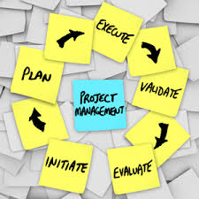
Software Project Manager-level Activities
Conducting a Project Kickoff Meeting
with the help of the PMO
Arranging for a Phase-end Audit
final activity of the project initiation phase
a QA activity

Slide 35
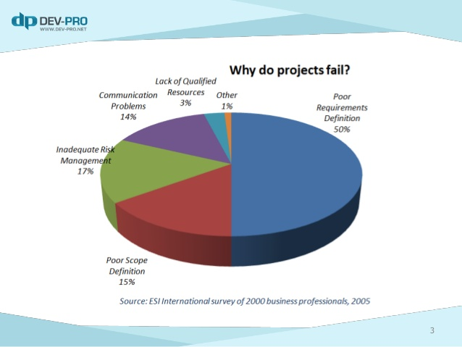
Common Pitfalls In Software Project Initiation
Identifying the wrong software Project Manager
Identifying Inappropriate resources
Incurring delays in software Project Initiation Activities

Slide 36
Reference:
Chapter 4: Software Project Initiation
Chemuturi, M., & Cagley, T. M. (2010). Mastering software project management: Best practices, tools and techniques. J. Ross Publishing.

Slide 37
Q & A

